Slide 1

AI for Job Trend Analysis
Name: Student Code:
Y.R.Rishidhar Reddy iitrpr_ai_25010526

Slide 2
Problem Overview
💡The Solution
🎯 The Challenge
Job markets change rapidly across countries and roles
Students and professionals lack data-driven insights on which jobs are booming
Raw job datasets are large, complex, and hard to interpret
Manual analysis is slow and subjective
Build an AI system that analyzes job data and identifies future-ready and booming job roles by country

Slide 3
System Design & Workflow
Data Input: User uploads job dataset (CSV)
Data Preprocessing: Feature preparation and cleaning
Model Selection:
Use pre-trained ML models (instant predictions)
Train a custom model (flexible analysis)
Prediction: Model generates trend scoring
Visualization: Insights delivered via Streamlit dashboard

Slide 4
Three-Layer Architecture
📊 Data Processing Layer
🤖 Machine Learning Layer
📈 Visualization & Dashboard Layer
Data validation and cleaning
Feature encoding and scaling
Multiple regression models
Pre-trained model repository
Custom model training pipeline
Interactive Streamlit interface
Real-time predictions
Downloadable results

Slide 5
Data & Model Design
Dataset Features
ML Models Implemented
Model | Type | Purpose
Random Forest | Ensemble | Primary model (R² = 0.65)
XGBoost | Gradient Boosting | High accuracy alternative
Extra Trees | Ensemble | Fast predictions
Gradient Boosting | Sequential | Iterative improvement
LightGBM | Gradient Boosting | Large dataset efficiency
Linear Regression | Baseline | Comparison benchmark
job_title – Job role/title
company_name – Name of the hiring company
company_location – Country or region of the job
company_size – Size category of the organization
employment_type – Full-time, Part-time, Contract, etc.
experience_level – Required experience level
education_required – Minimum education requirement
salary_usd – Salary offered (numeric)
application_deadline – Job application deadline (numerically encoded)

Slide 6
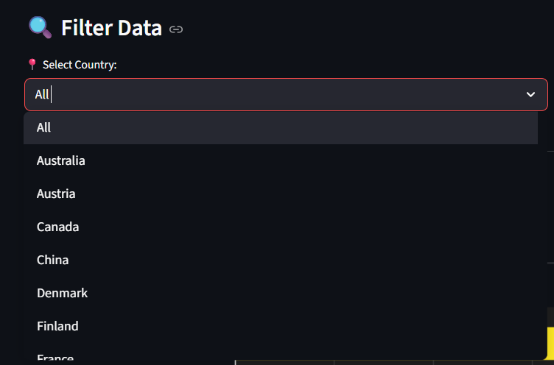
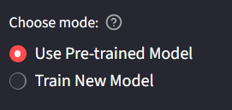
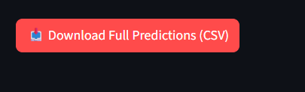
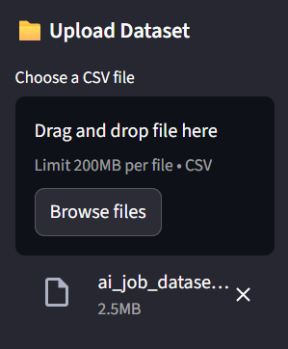
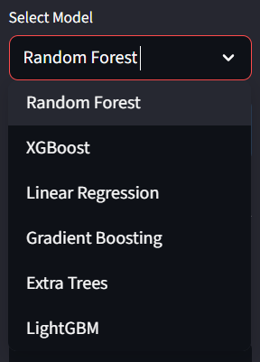
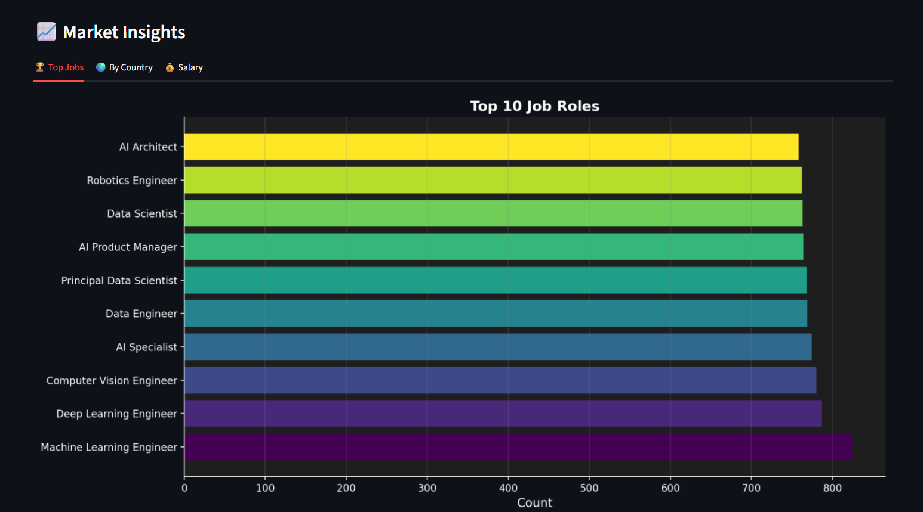
Demo Snapshots

Slide 7
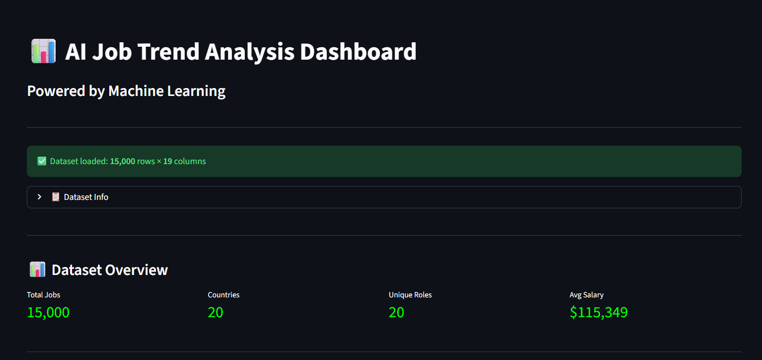

Slide 8
Model Results & Evaluation
Evaluation Metrics
RMSE (Root Mean Squared Error): Measures prediction accuracy
R² Score: Explains variance in trend scores (0-1 scale)
Model | RMSE | R² Score | Performance
Random Forest | 0.82 | 0.65 | ⭐ Best Overall
XGBoost | 0.82 | 0.65 | ⭐ Co-Leader
Extra Trees | 0.83 | 0.64 | Strong
LightGBM | 0.86 | 0.61 | Good
Gradient Boosting | 0.89 | 0.58 | Moderate
Linear Regression | 1.35 | 0.04 | Baseline

Slide 9
Key Learnings
🔧 Feature Engineering
Learned importance of maintaining feature consistency between training and deployment
Implemented feature_names.pkl to prevent feature mismatch errors
📊 Model Comparison & Selection
Gained experience comparing multiple ML algorithms systematically
Learned to select models based on multiple metrics (RMSE, R²)
🚀 Deployment Challenges
Solved real-world deployment issues (feature mismatch, model loading)
Learned proper model serialization with pickle
📈 Data Visualization
Built interactive dashboards with Streamlit
Learned to present AI outputs to non-technical users

Slide 10
THANK
YOU !
*I Also used Claude and ChatGPT for assistance.
Project Repository: Github link
Live Dashboard: App link
Documentation: Doc Link

